Slide 1
Radwa Younis 1th of Jan 2024
Web Automation Using Cypress

Slide 2


Agenda
What is Cypress
Cypress Features
Install PyTest
PyTest Fixture
Skip Testcase
Order Testcase
Grouping Testcases
Dependency Testcase
parameterize
PyTest HTML report
PyTest Allure report

Slide 3

What is Cypress ?
Notes:
Cypress is a NodeJS-based modern automation tool that supports JavaScript/Typescript as the programing language. for front-end testing ,it operates directly on the browsers .

Slide 4
Cypress Features
No need of using external drivers
interactive debugger
Supports cross browser testing
Takes screenshots as your tests execute
Built in video recording
Built in reporting dashboard
It has a readymade framework structure
Automatically handles implicit/explicit waits
Assertions are built in
Can test APIs
Mocking is possible
Notes:
https://medium.com/@vohrakritika9/cypress-a-sneak-peek-bef5c10f73b5

Slide 5
Cypress Installing

Slide 6
Advantages Of POM
Page Object Design Pattern says operations and flows in the UI should be separated from verification. This concept makes our code cleaner and easy to understand.
The Second benefit is the object repository is independent of test cases, so we can use the same object repository for a different purpose with different tools
Code becomes less and optimized because of the reusable page methods in the POM classes
Methods get more realistic names which can be easily mapped with the operation happening in UI. i.e. if after clicking on the button we land on the home page, the method name will be like ‘gotoHomePage()’.

Slide 7
PyTest
Notes:
pytest is a open-source testing framework that allows users to write test codes using Python programming language.

Slide 8
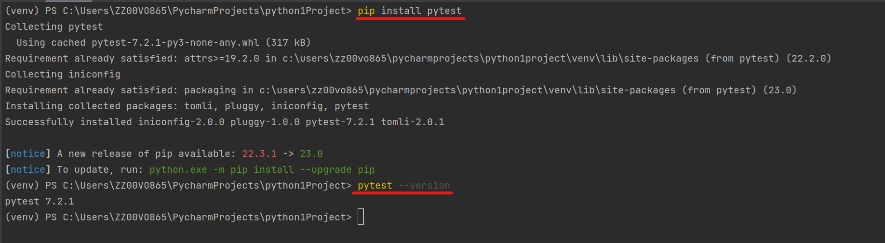
Install PyTest
Notes:
install pytest in terminal -> pip install pytest
Once the installation is complete you can confirm it with -> pytest --version

Slide 9
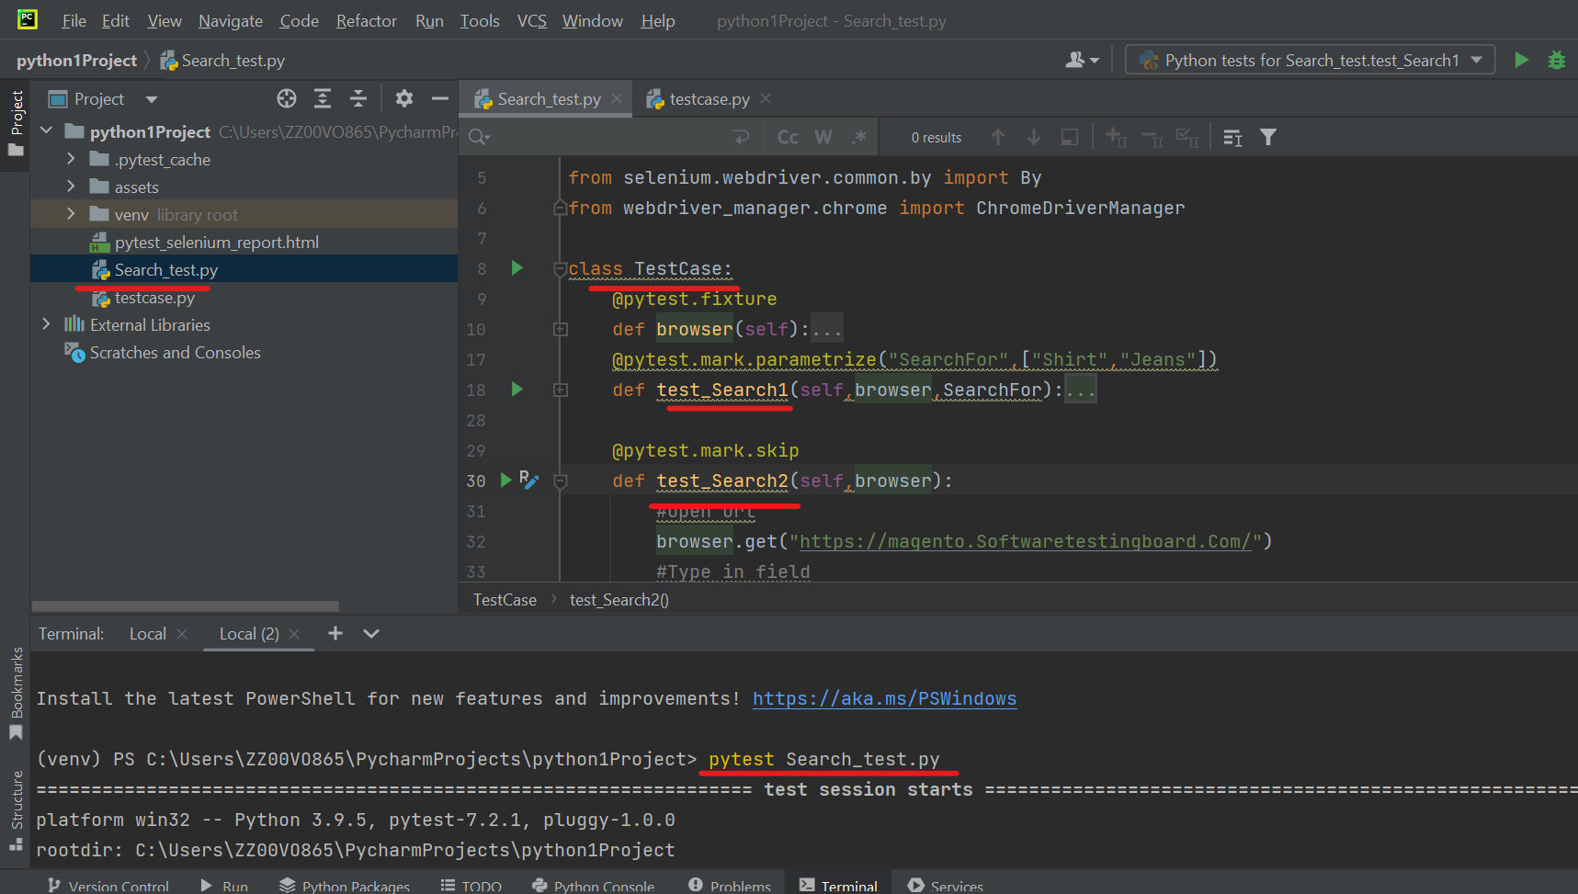
use PyTest
Notes:
File name have name convention of *_test.py / test_*.py
Class name have name convention containing “Test” word
pytest will search for test functions named test_*
Run using pytest in the terminal -> pytest Search_test.py

Slide 10
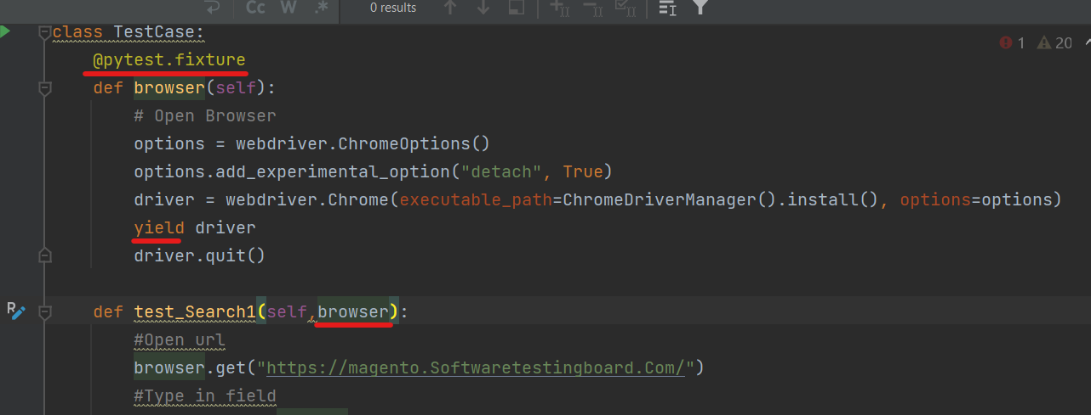
pytest Fixture
A function is marked as fixture using the following marker:
@pytest.fixture
Notes:
pytest fixtures are functions attached to the tests which run before the test function is executed and cleaned up once the Selenium test automation execution is completed.
In the above example, a fixture is written with a browser name. When you run the above program, it will create a driver instance for each test

Slide 11
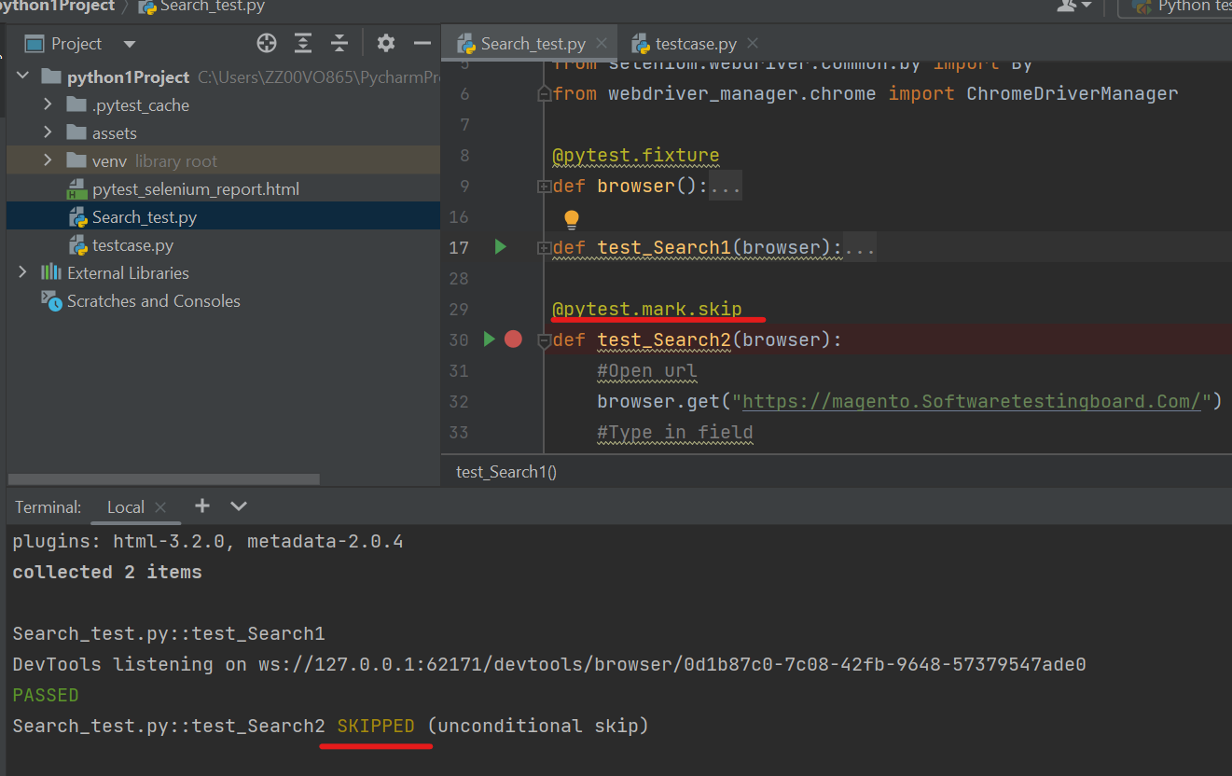
Skip Testcase
A function is marked as skiped using the following marker:
@pytest.mark.skip

Slide 12
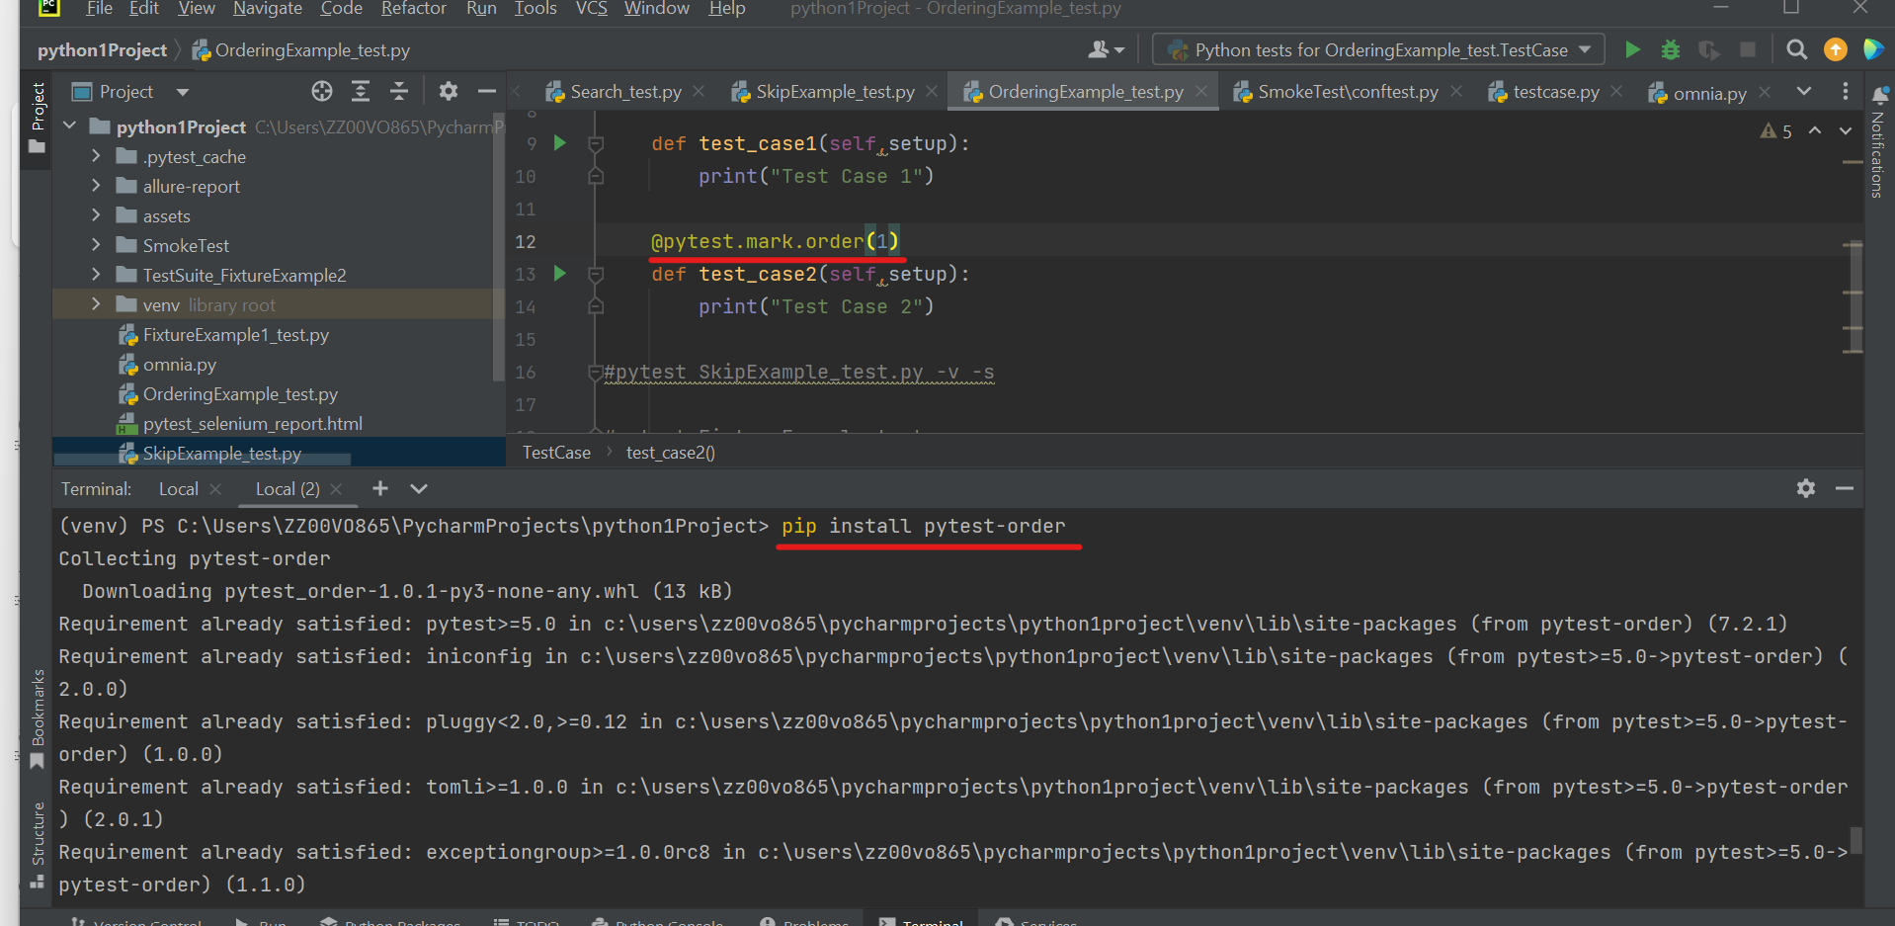
Order Testcase
Defines the order marker that you can use in your code with different attributes.
@pytest.mark. order(1)
Notes:
Install in the terminal -> pip install pytest-order

Slide 13
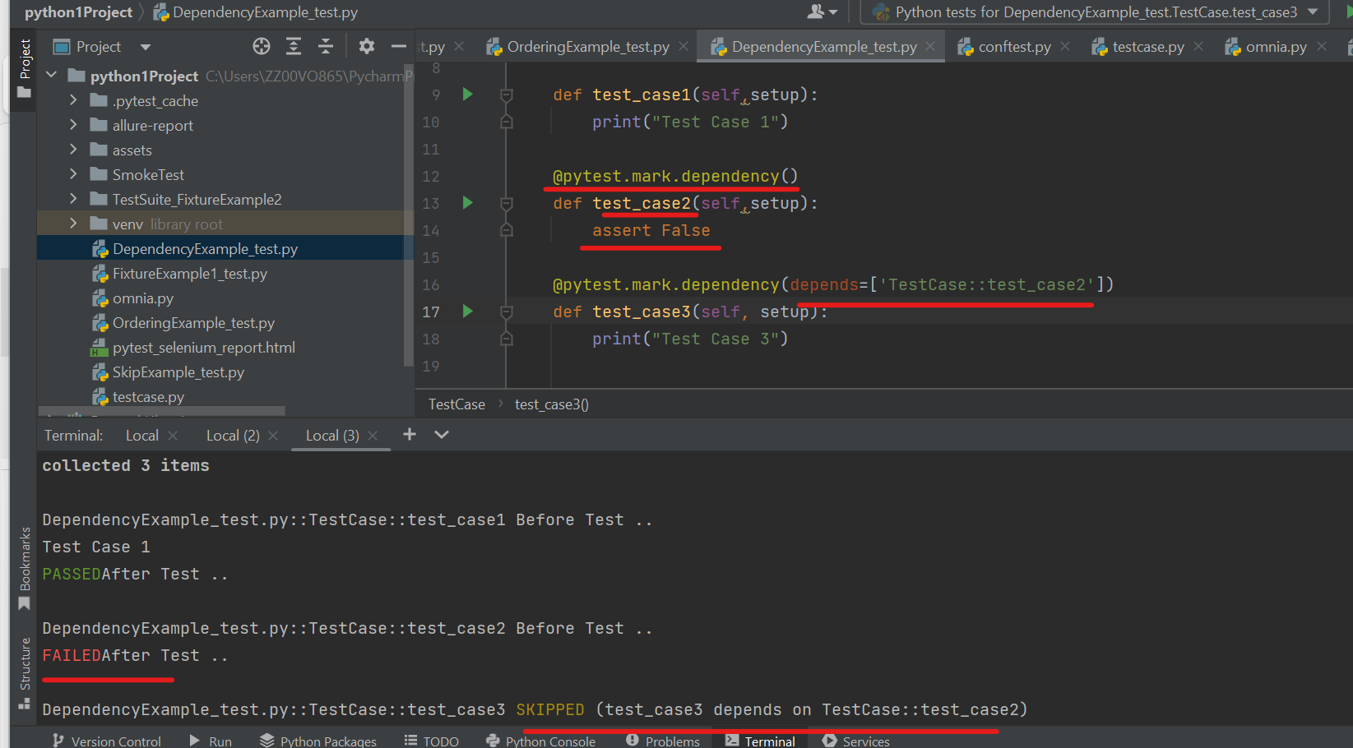
Dependency Testcase
Notes:
Install in the terminal -> pip install pytest-dependency
Mark first test case with -> @pytest.mark.dependency()
Mark second test case with -> @pytest.mark.dependency(depends=[ClassName::test_caseName’])
- If the first test case failed the second one will be skipped

Slide 14
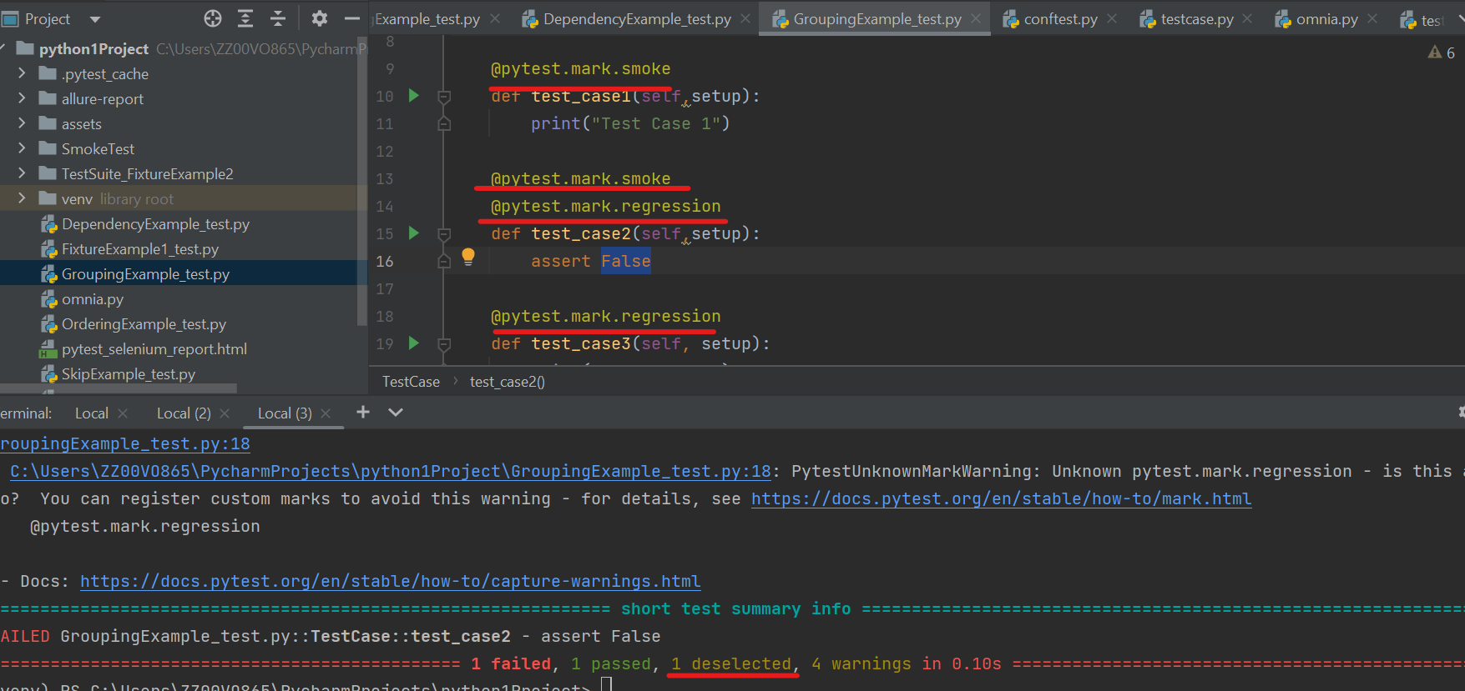
Grouping Testcases
Notes:
To run the group test cases add –m ”group name” to the terminal command
pytest -v -s -m "regression" GroupingExample_test.py -> execute tc 1 and 2
pytest -v -s -m "smoke" GroupingExample_test.py -> execute tc 2 and 3
pytest -v -s -m "smoke and regression" GroupingExample_test.py-> -> execute tc 2
pytest -v -s -m 'not smoke' GroupingExample_test.py ->-> execute tc 3
pytest -v -s -m 'not regression' GroupingExample_test.py -> execute tc 1

Slide 15
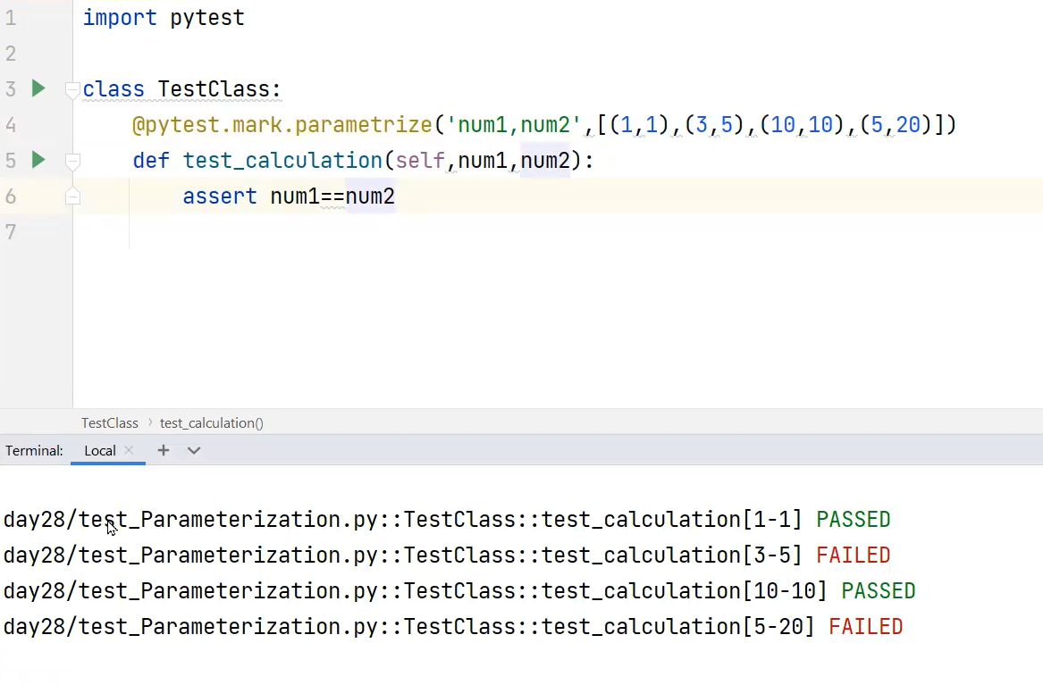
parameterize
Notes:
@pytest.mark.parametrize(“Parameter",[“Value1",“Value2"])

Slide 16
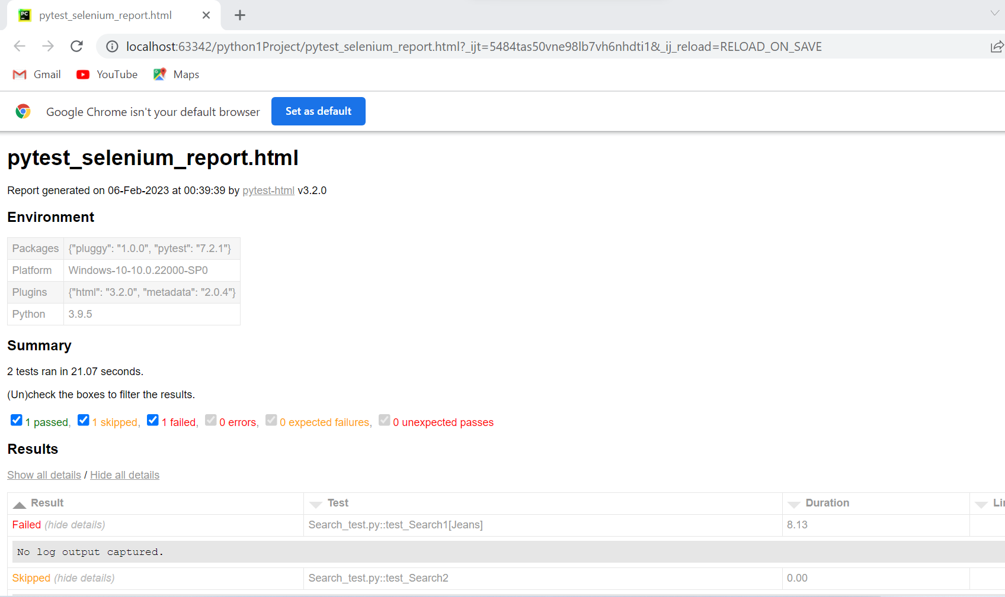
PyTest HTML Report

Slide 17
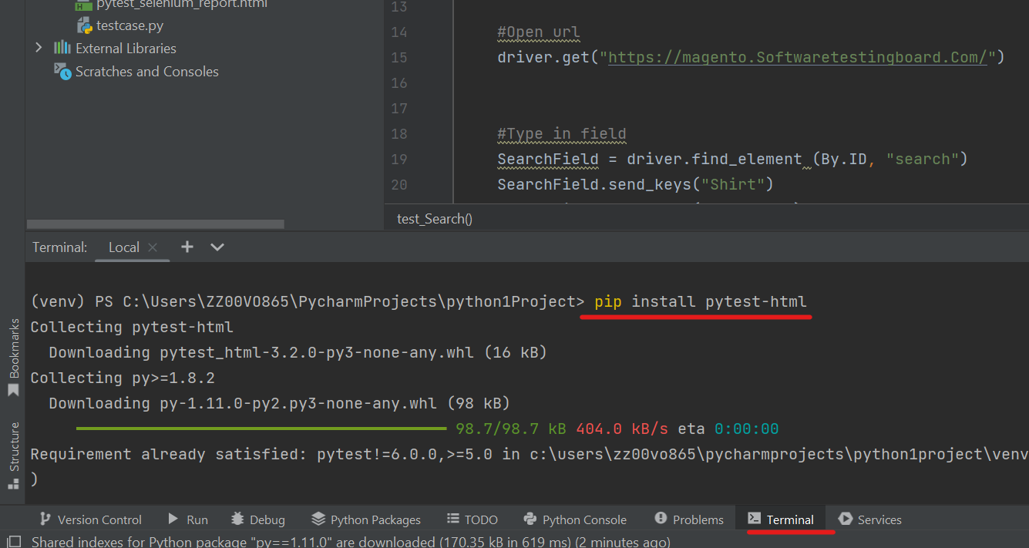
Install PyTest HTML Report
Notes:
install pytest HTML report in terminal> pip install pytest-html

Slide 18
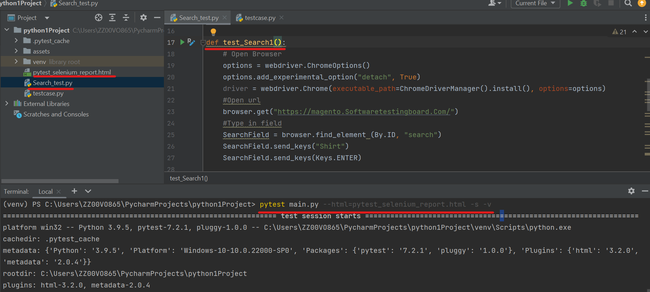
Generate PyTest HTML Report
Notes:
Executed test case and generate an HTMLreport in terminal-> pytest Search_test.py --html=pytest_selenium_report.html -s -v

Slide 19
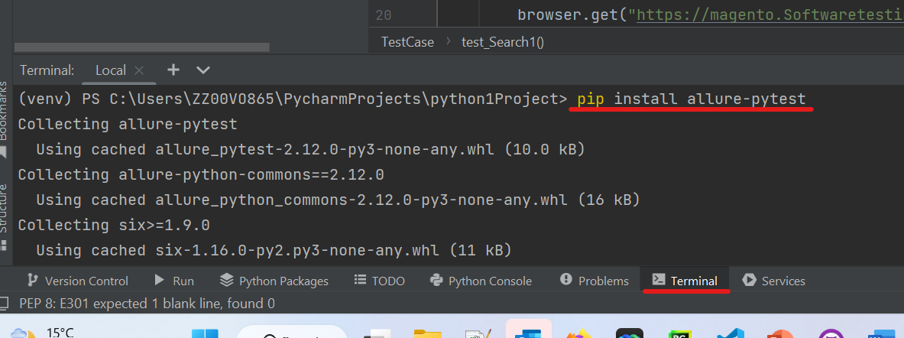
Install PyTest Allure Report
Notes:
install pytest HTML report in terminal> pip install allure-pytest

Slide 20
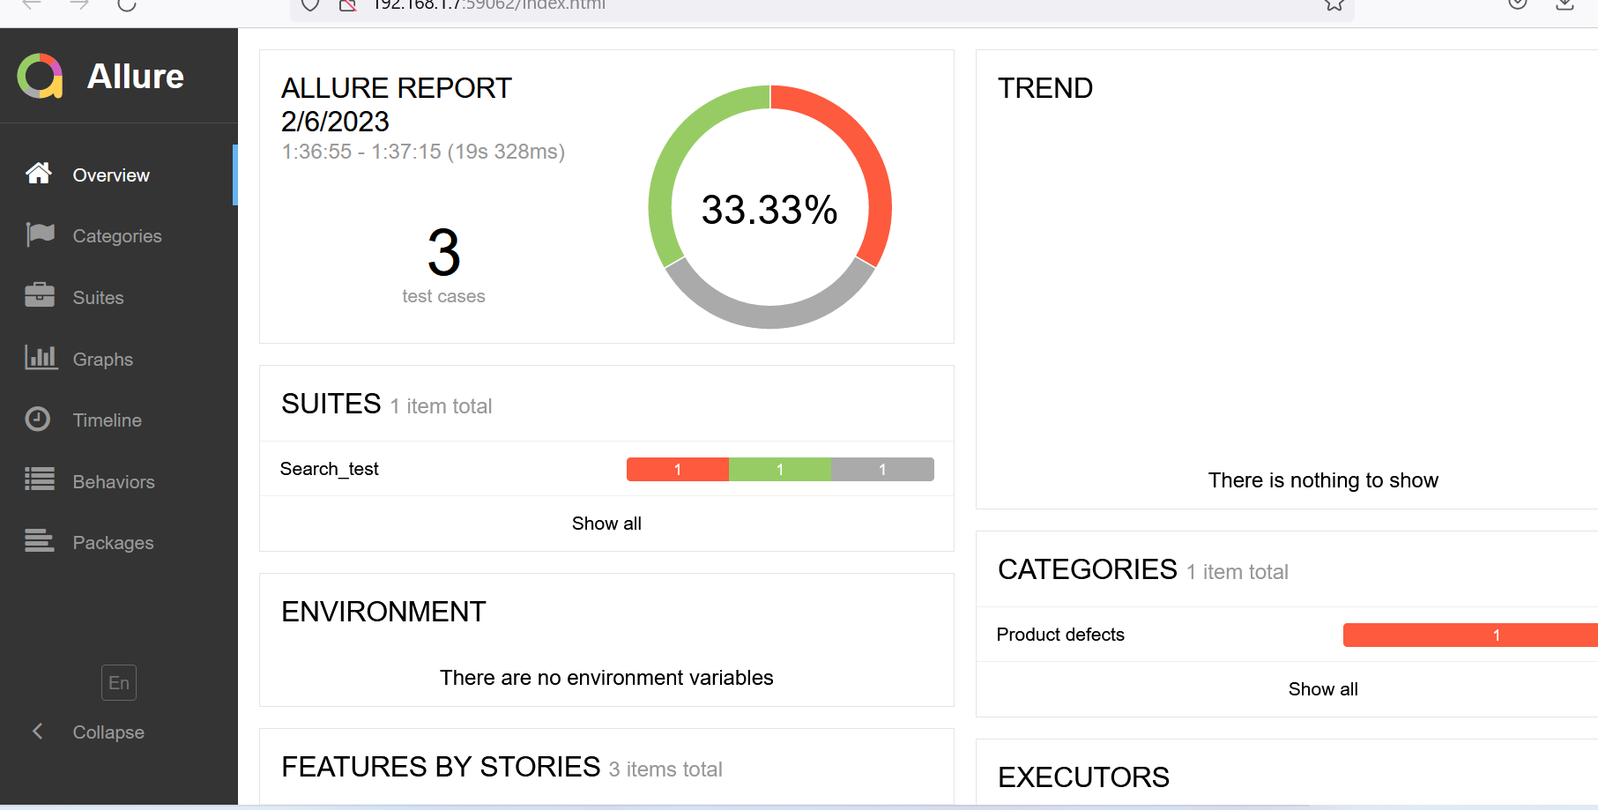
PyTest Allure Report

Slide 21
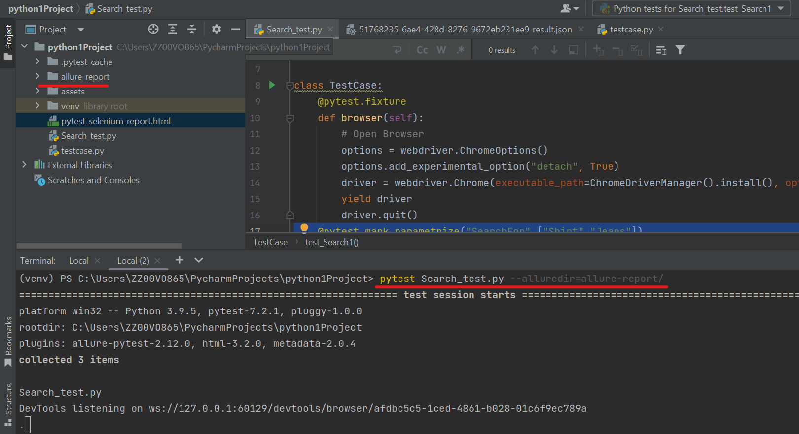
Generate PyTest Allure Report
Notes:
Executed test case and generate an HTMLreport in terminal-> pytest Search_test.py --alluredir=allure-report/

Slide 22
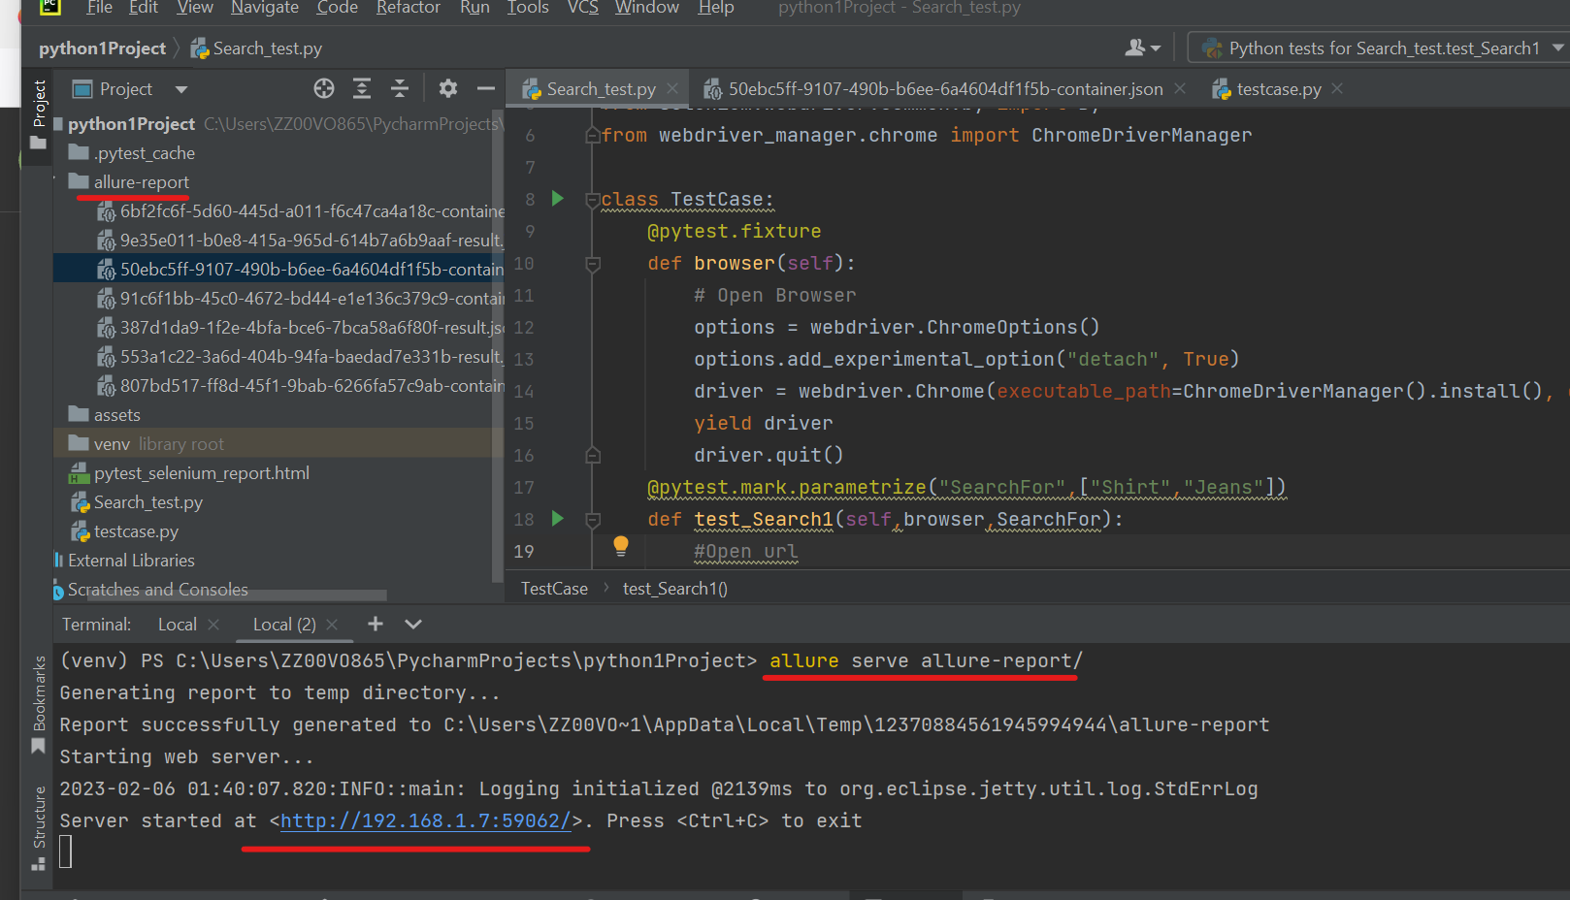
Open PyTest Allure Report
Notes:
Open allure report in terminal ->allure serve allure-report/

Slide 23
Materials
https://ibm-learning.udemy.com/course/selenium-python-step-by-step-for-beginners/learn/lecture/12107342?start=15#overview
Weeks | Content | Deadline
Week 1 | Sections: 2, 3, 4, 5, 6 To refresh Python knowledge: Sections: 9, 10 | 29th of January
Week 2 | Sections : 7, 8, 11, 12, 13, 14 | 5th of February
Week 3 | Assignment 1 | 12th of February
Week 4 | Sections: 15, 16, 17, 18, 19 | 19th of February
Week 5 | Sections: 20, 21, 22, 23 Optional: 24 | 26th of February
Week 6 | Assignment 2 | 5th of March

Slide 24
References
https://www.guru99.com/page-object-model-pom-page-factory-in-selenium-ultimate-guide.html
https://www.selenium.dev/documentation/test_practices/encouraged/page_object_models/
https://selenium-python.readthedocs.io/page-objects.html

